Slide 1

Advanced Android Root：
How to Bypass PXN
JianjiangZhao GengjiaChen JianfengPan
2016

Slide 2
About the Authors
JianqiangZhao
JianqiangZhao is a security researcher of IceSword Lab from 360 company who focus on developing Linux kernel driver and exploiting Android kernel vulnerabilities.(@jianqiangzhao, zhaojianqiang1@gmail.com) 。
GengjiaChen
GengjiaChen is a security researcher of IceSword Lab who works on finding and exploiting Android kernel vulnerabilities.(@jiayy)。
JianfengPan
JianfengPan is the leader of IceSword Lab(@pjf).

Slide 3
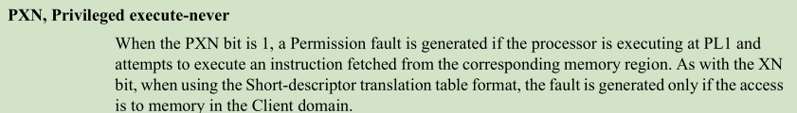
What is PXN ?
PXN is one of the vulnerability mitigation strategies of ARM, it can block running of userspace shellcode in kernel context with a permission fault.
The Privileged Execute-never bit, is a bit in the descriptor fields of a page entry, when supported, determines whether the processor can execute software from the region when executing at PL1.

Slide 4
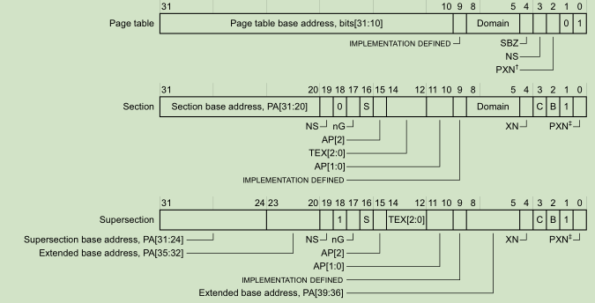
What is PXN ?
PXN bit in arm first-level page entry

Slide 5
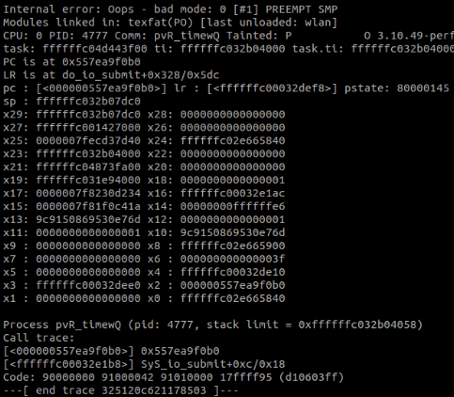
What is PXN ?
2014, some of the samsung arm32 devices with PXN enabled
2015，all aarch64 devices with PXN enabled
USER
&shellcode
KERNEL
func()
NO PXN
PXN -> shellcode -> crash

Slide 6
PXN Bypass with ROP/JOP
PXN disabled, userspace shellcode
Privilege escalation
Close SELinux or change SELinux context
Restoration
PXN enabled，patch addr_limit
Leak stack address -> addr_limit address
patch addr_limit
Read&&write kernel data

Slide 7
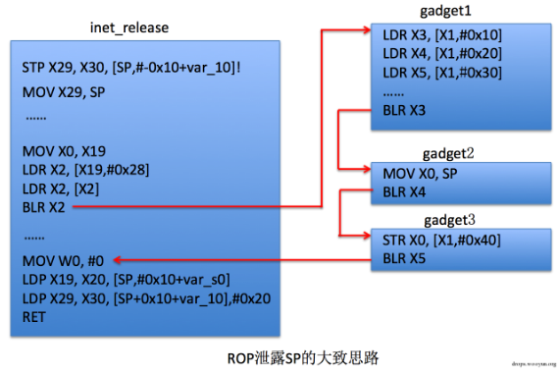
PXN Bypass with ROP/JOP – example 1
《A Research on the PXN Protection Technique and The Method to Avoid PXN》
CVE-2015-3636: control X1 register, create the rop chain, leak sp address

Slide 8
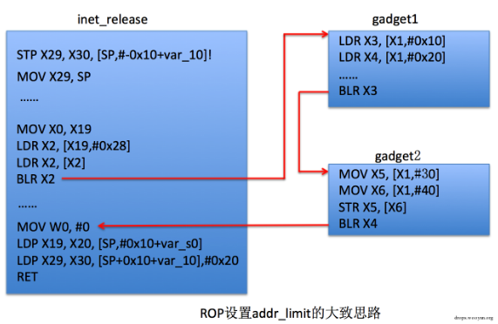
PXN Bypass with ROP/JOP – example 1
Set addr_limit to 0xFFFFFFFFFFFFFFFF with rop chain

Slide 9

PXN Bypass with ROP/JOP – example 2
《 Own your Android! Yet Another Universal Root 》
CVE-2015-3636: X0 is a controlled address in userspace，X1 is the address of sp register，X2 is another controlled address in userspace
Patch addr_limit：X0 is address of addr_limit minus 0x14，X1 is the register whose value is 0xFFFFFFFFFFFFFFFF，X2 is a controlled address in userspace

Slide 10
Summary
Need two steps
Hard to find rop gadgate
Poor universality

Slide 11
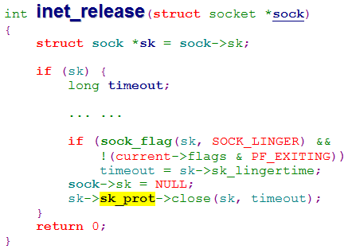
Let’s begin with CVE-2015-3636 。。。
Disclosed in 2015
More and more devices with PXN enabled
We can control: 1）the value of the memory pointed by sk pointer 2）R0/X0

Slide 12
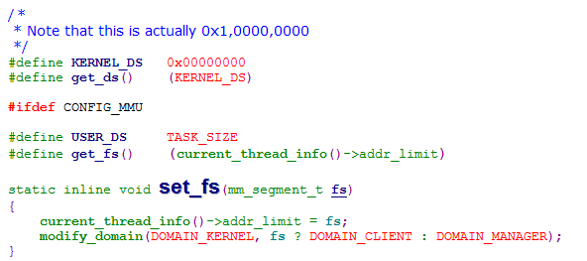
How to patch addr_limit
A gift from kernel - set_fs(KERNEL_DS)

Slide 13
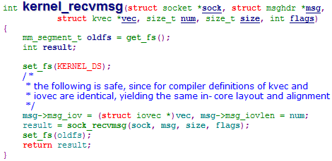
How to patch addr_limit
set_fs - A typical scenario

Slide 14
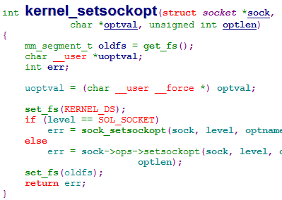
Jump！
sock->ops->setsockopt

Slide 15
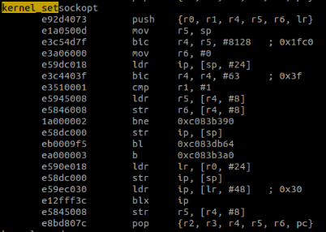
ARM32 PXN BYPASS
Arm32 - control the flow with r0

Slide 16
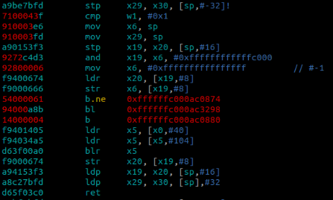
Aarch64 PXN BYPASS
Aarch64 - control the flow with X0

Slide 17
SMEP？！
Break the stack frame – trouble from call/callq instruction
call && callq
ret && retq

Slide 18
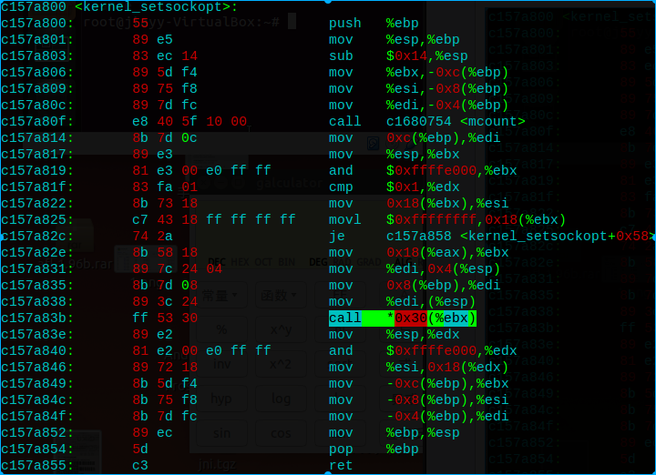
X86 SMEP BYPASS
X86 - control the flow with eax

Slide 19
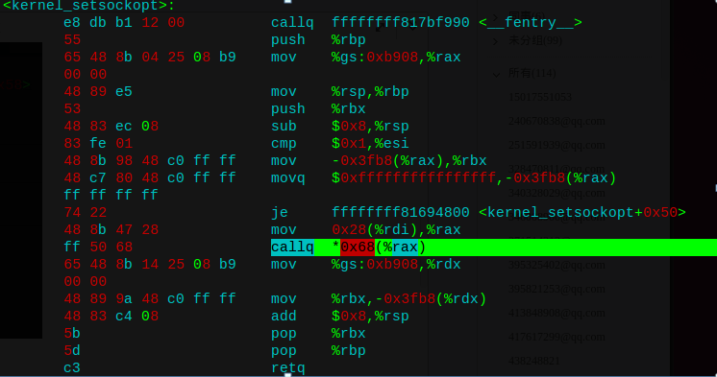

X64 SMEP BYPASS
X64 - control the flow with rdi

Slide 20
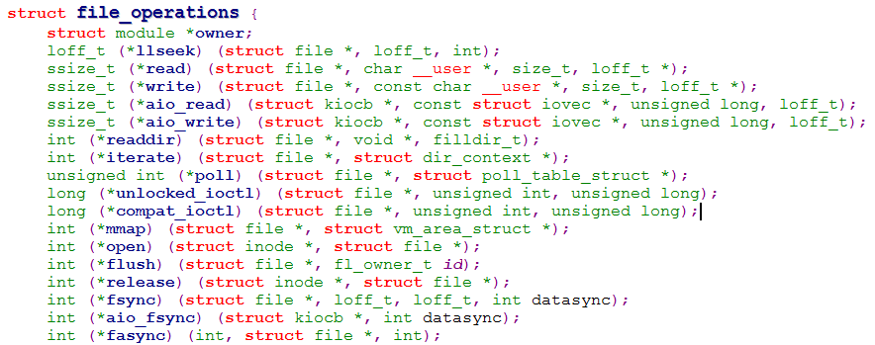
X0 Control
How to control X0 without vuln

Slide 21
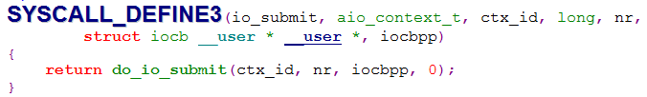
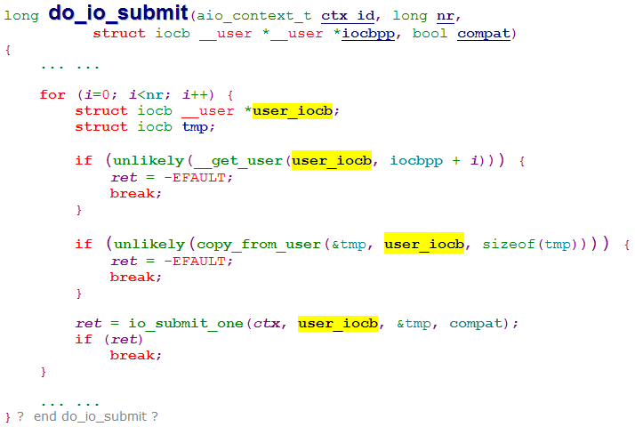
X0 Control
Asynchronous io– io_submit

Slide 22
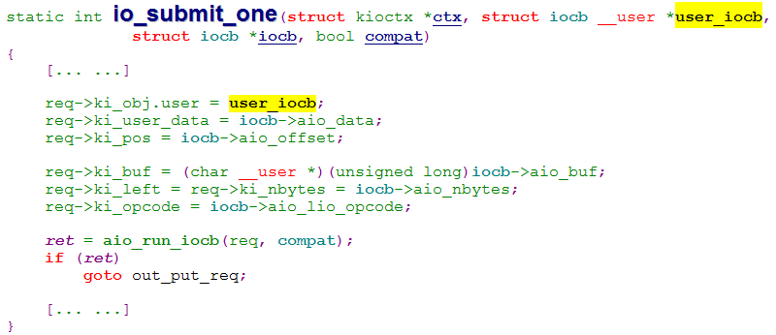
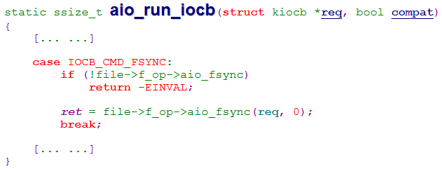
X0 Control
Asynchronous io– io_submit

Slide 23
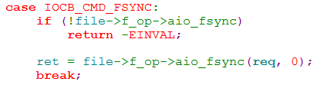
X0 Control
io_submit -> aio_fsync -- x0 controlled !!

Slide 24
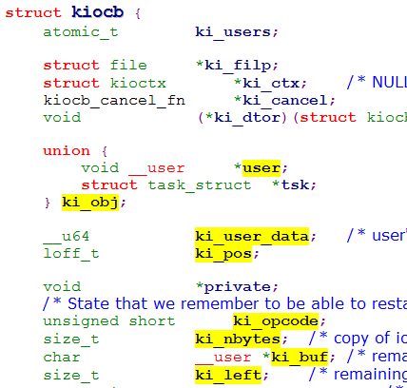
X0 Control
Which fields can be contolled

Slide 25
X0 Control
struct kiocb in kernel versions
Kernel Version | arm | aarch64 | x86 | X86_64
3.10 | √ | √ | √ | √
3.11 | √ | √ | √ | √
3.12 | √ | √ | √ | √
3.13 | √ | √ | √ | √
3.14 | √ | √ | √ | √
3.15 | √ | √ | √ | √
3.16 | √ | √ | √ | √
3.17 | √ | √ | √ | √
3.18 | √ | √ | √ | √
3.19 | √ | √ | √ | √
4.0 | √ | √ | √ | √

Slide 26
Summary
Trigger once
Good universality, kernel version > 2.6
ARM && ARM64 && X86 && X64
No stack damage
Easy for porting

Slide 27
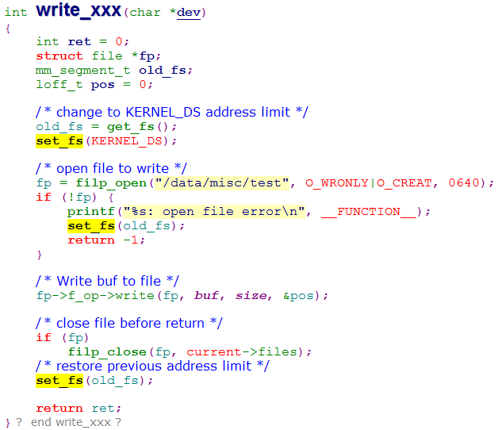
PXN Bypass with A Bug
set_fs - Another typical scenario

Slide 28
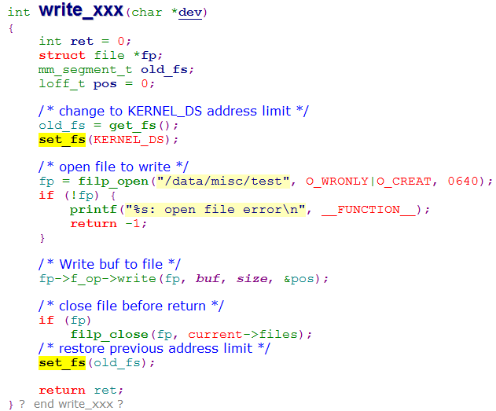
PXN Bypass with A Bug
Open the door to kernel，but forget to close it
Call it -> Bypass PXN

Slide 29
Summary
Similar way，more simple
Well-designed mitigation bypassed with a bug
Only in certain platform

Slide 30

Rop can also be simple
Is patching addr_limit necessary?
We have other way ...

Slide 31

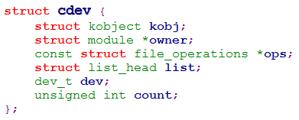
Rop can be simple
Shellcode in userspace？NO
Kernel data structure in userspace？YES
Example：
ops
ptmx_cdev

Slide 32
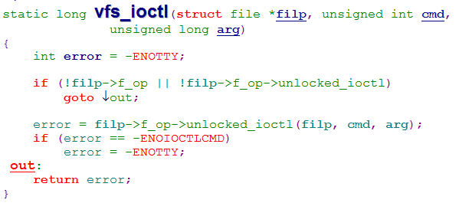
Rop can be simple
By ioctl, we can control x1, x2

Slide 33
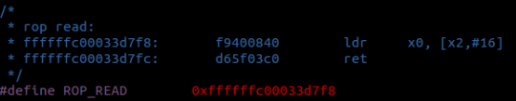
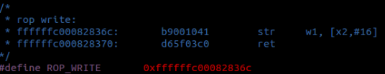
Rop can be simple
Read && write kernel data with two simple rop gadgets
rop read
ops->ioctl
rop write
ptmx_cdev
rop_read
rop_write

Slide 34
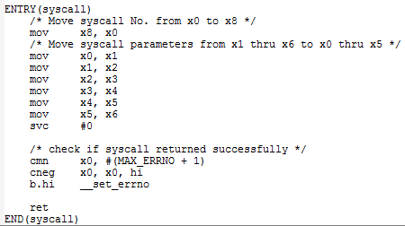
Rop can be simple
Ioctl just return 0 or -1 in glibc（bionic）, return value is changed when less than 0.
bionic syscall

Slide 35
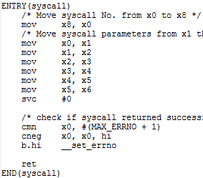
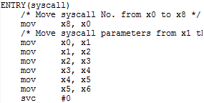
Rop can be simple
We need original return value from kernel，so we need our own syscall
bionic syscall
my syscall

Slide 36
Summary
What is PXN
Normal rop/jop way to bypass pxn
Our three solutions

Slide 37

Thank You !
北京奇虎科技有限公司

